Slide 1

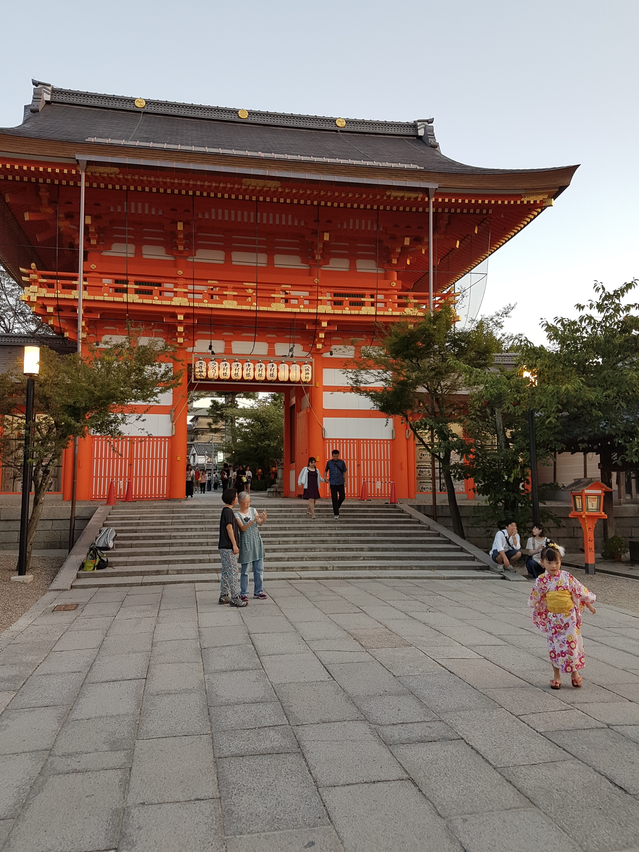
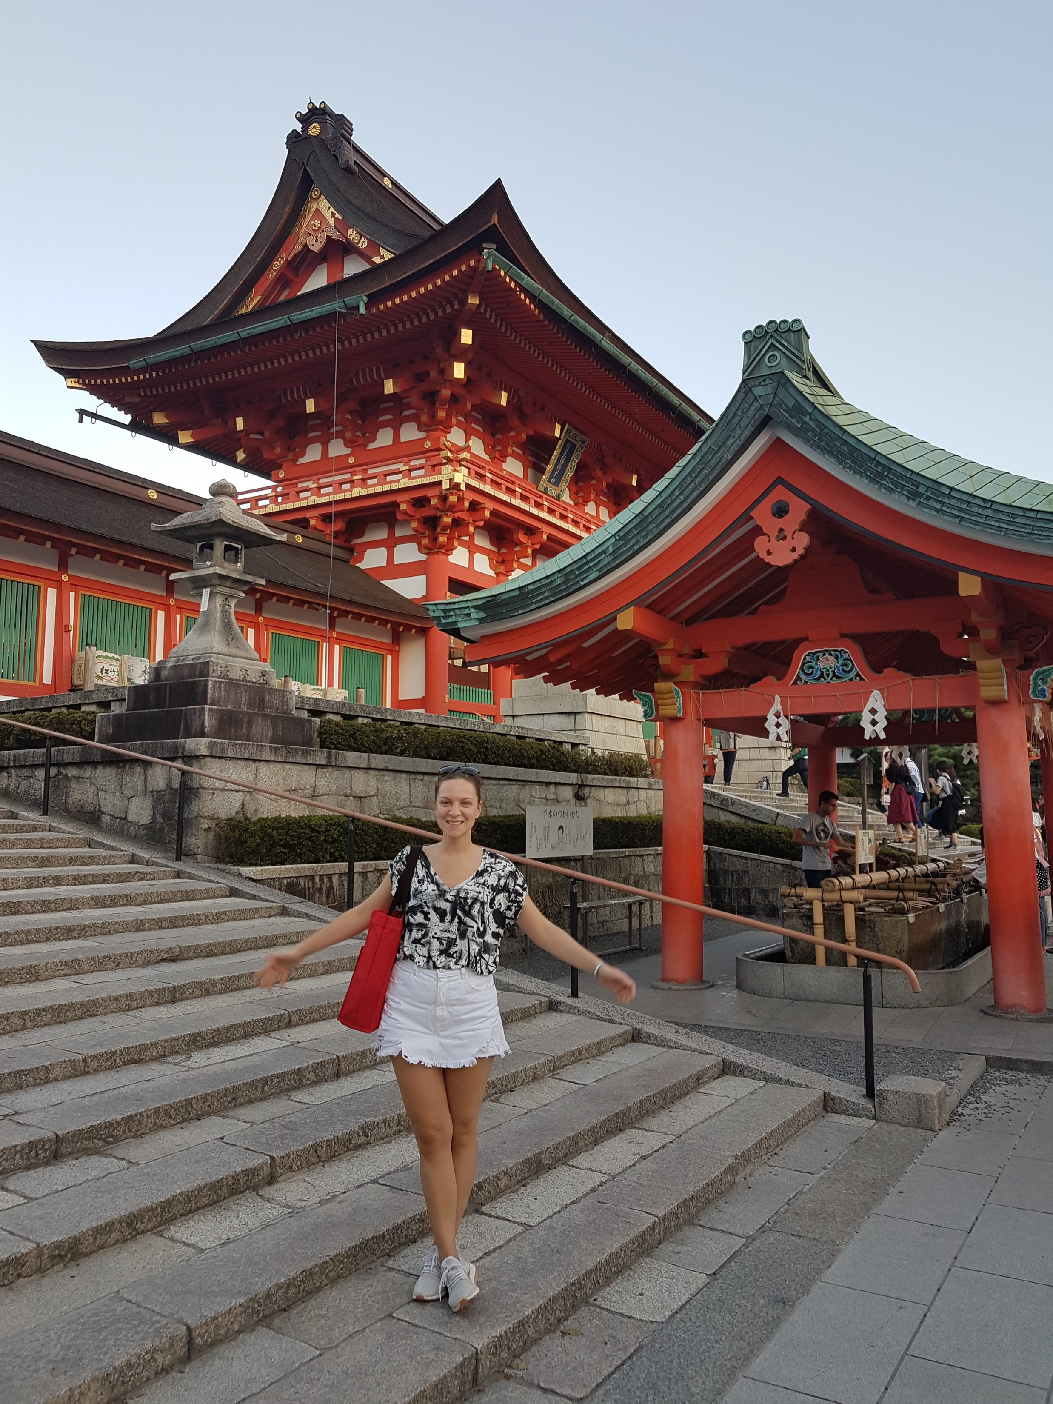
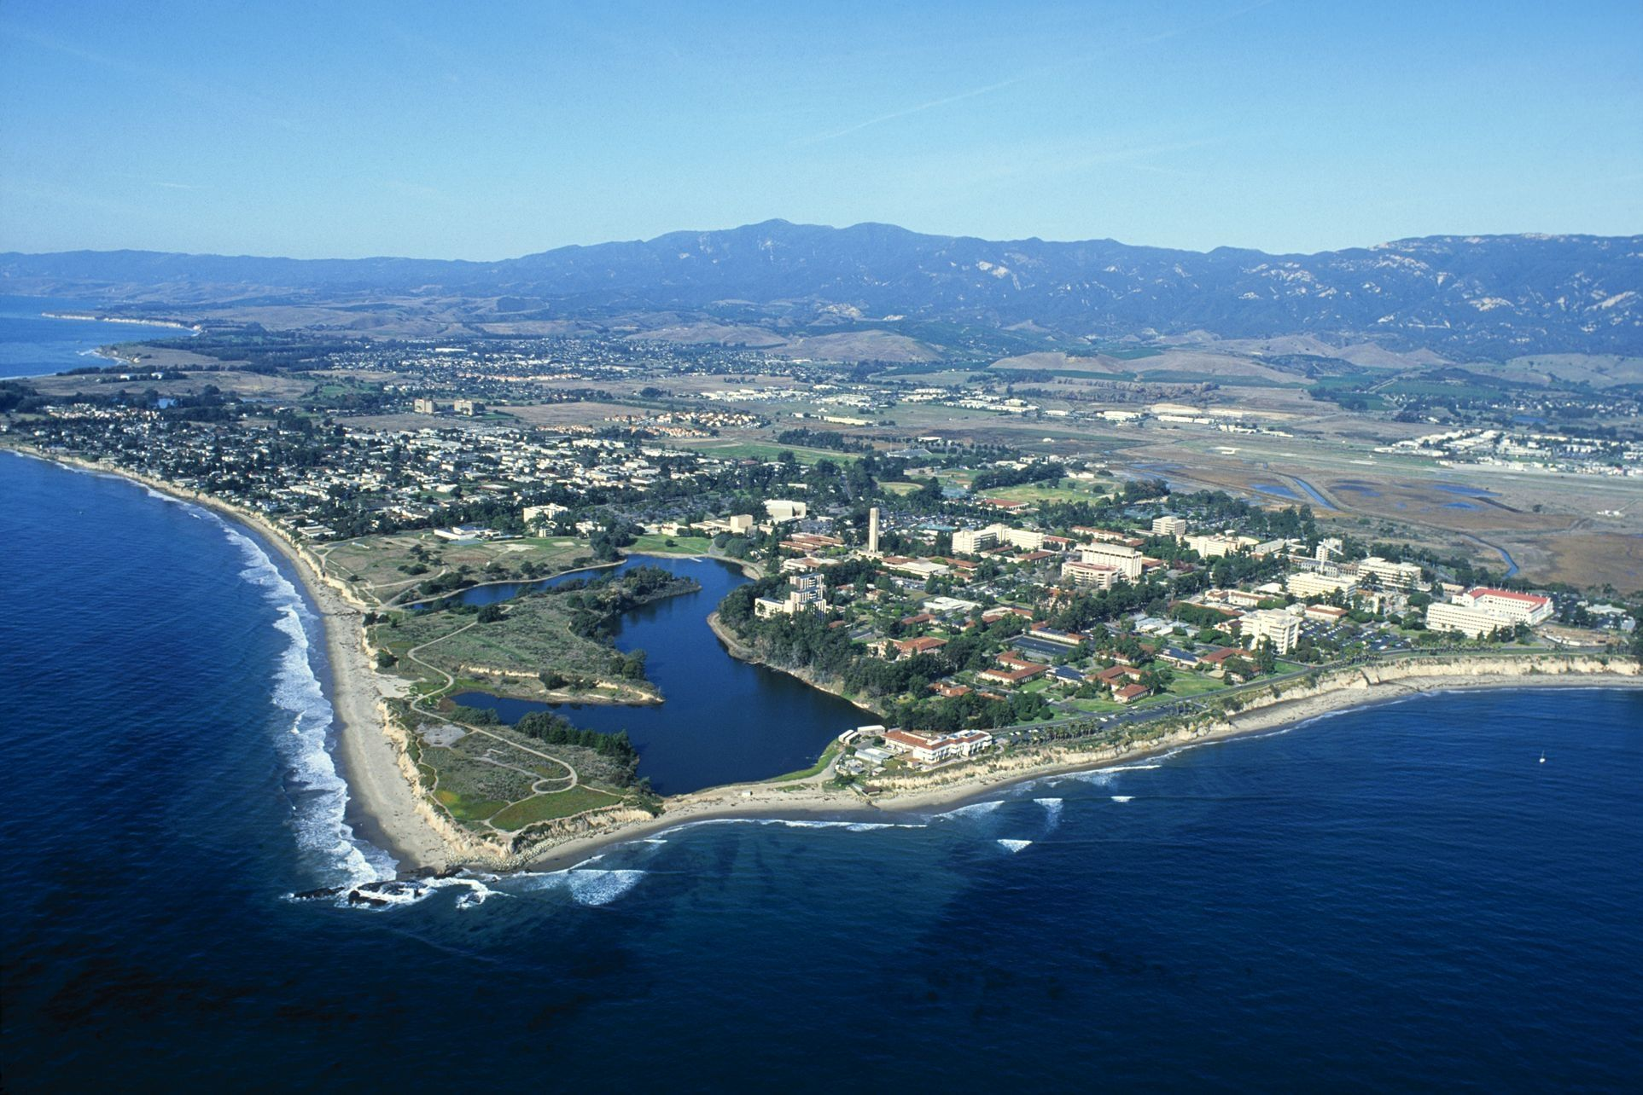
SAŠA GAZIBEGOVIĆ sasa.gazibegovic@gmail.com
PMF Eksperimentalna fizika Bachelor (2009-2013)
PMF Eksperimentalna fizika Master (2013-2014)
TNO/Holst Centre Master internship (2013-2014) 9 mjeseci
Doktorat (PhD) (2015-2019) 4 godine
Technicki Univerzitet u Eindhovenu i Delftu
Nanowire workshop Barcelona (May 2015)
Sino Dutch Summer School Sangaj (August 2016)
MBE IC Montpelier (Septembar 2016)
Station Q meeting Santa Barbara (Decembar 2016)
UCSB Santa Barbara (Februar 2017)
Nanowire workshop Lund (Maj 2017)
ICANS Seoul (Avgust 2017)
IUMRS Kyoto (Septembar 2017)
RIKEN institute Tokio (Septembar 2017)
CHAINS Eindhoven (Decembar 2017)
FOM Eindhoven (Januar 2018)
UCSB Santa Barbara (Februar 2018)
Quantum Designer San Sebastian (Juli 2018)

Slide 2
Internship opcije:
IAESTE
ERASMUS MUNDUS
JOIN EU…
Ili direktno:
TNO: https://www.tno.nl/en/career/internships-and-graduation-assignments/
Holst Center: https://www.holstcentre.com/careers/thesis-opportunities/
Solliance: https://www.solliance.eu
IMEC: https://www.imec-int.com/en/work-at-imec/master-thesis-internship
ASML: https://www.asml.com/internships/en/s32421
Philips: https://www.careers.philips.com/student/global/en/workingatphilips
High Tech Campus…
Google IT!
SUBMIT AN OPEN APPLICATION!
BE INTERESTED!
BE ENTHUSIASTIC!

