Slide 1
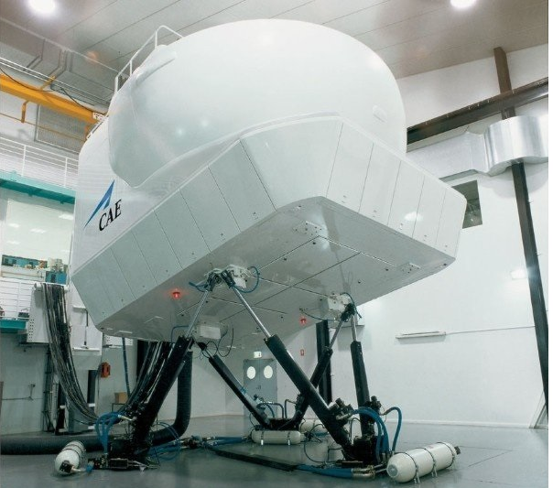
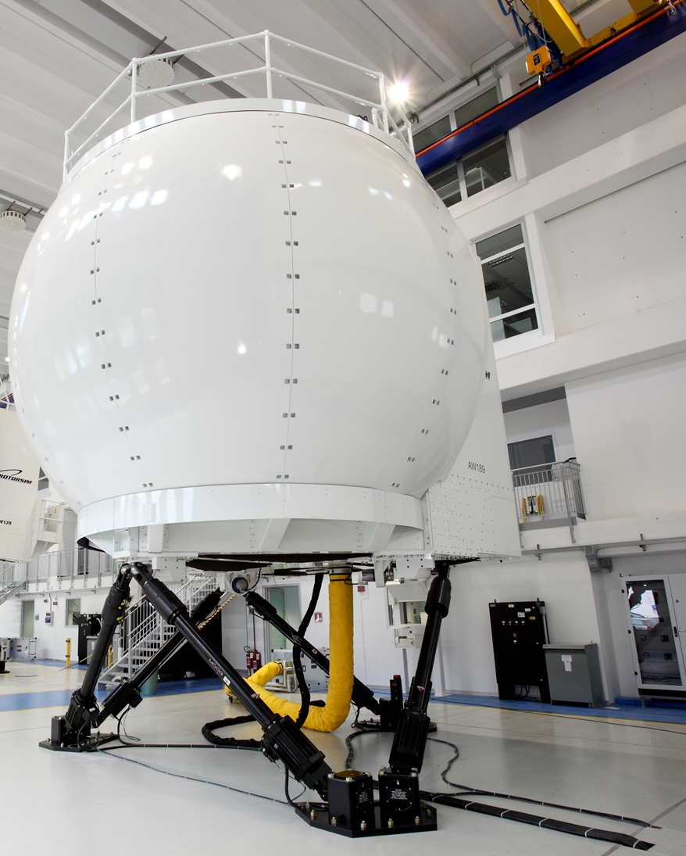
Flight simulators
Design and production
Borka Danilović,
Senior optical system designer
Technical lead VDS, CAE Inc
Sarajevo, October 2018

Slide 2
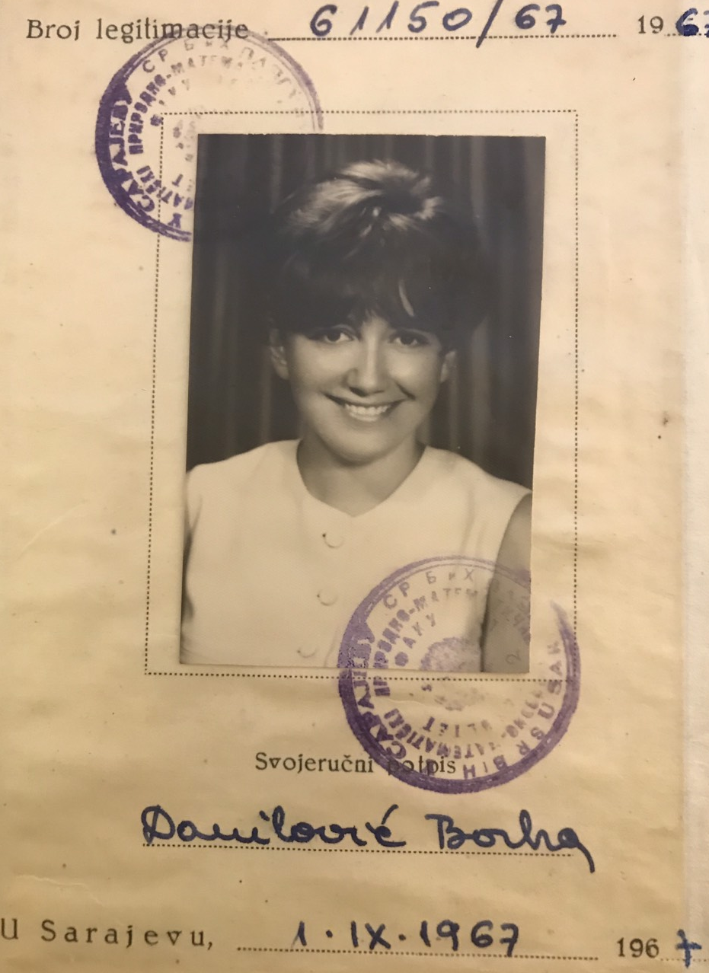
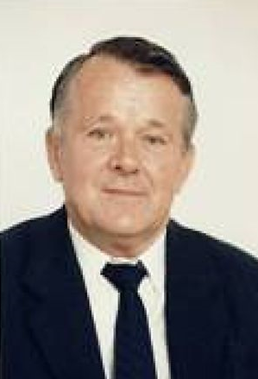
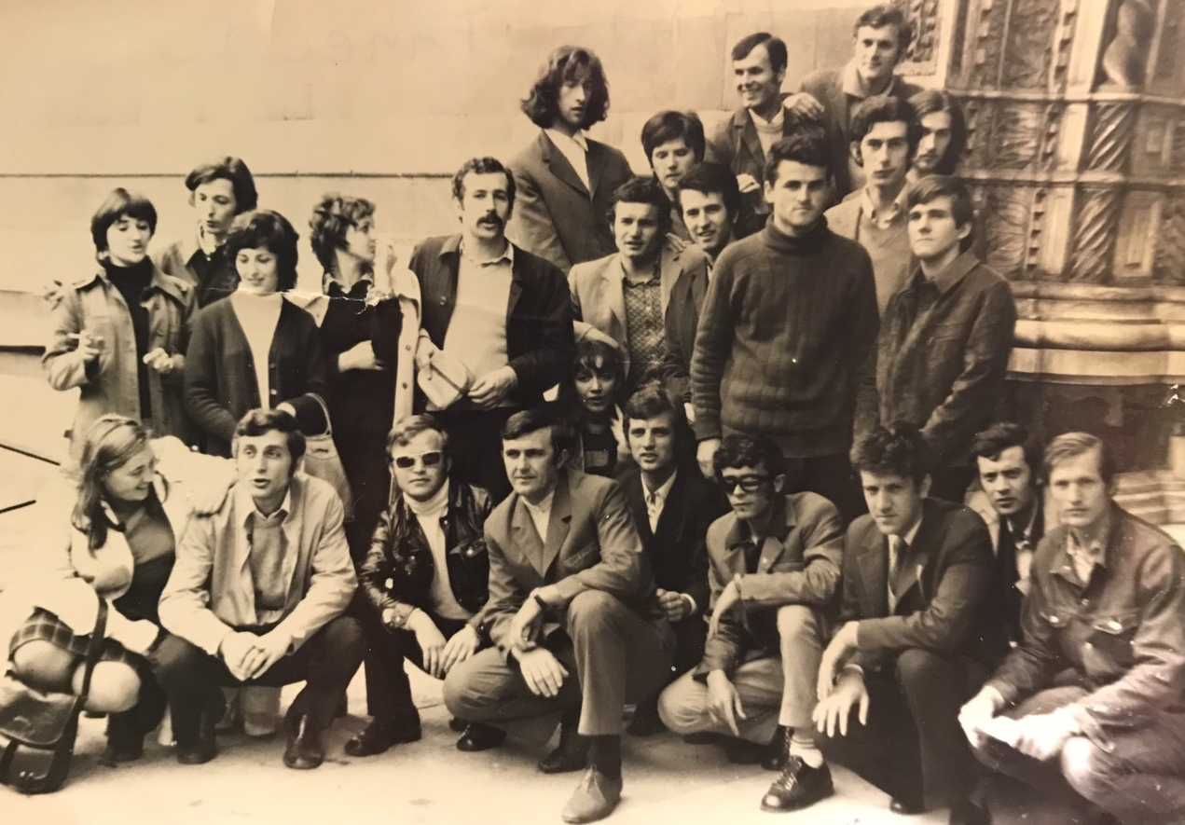
Borka Danilović
Prirodno Matematički Fakultet, Departement of Physics, University of Srajevo
Generation: 1967/68,
Graduated: Dec 1972
Prof. Dr. Krunoslav Ljolje
Ms. Sc. 1997, University of Sherbrooke, Canada
Work Experience: 45 years
“Zrak”, Srajevo, 1973 – 1985
“Unis Institut”, Sarajevo, 1985 – 1992
“CAE Inc”, Montreal, 1996 - 2018

Slide 3
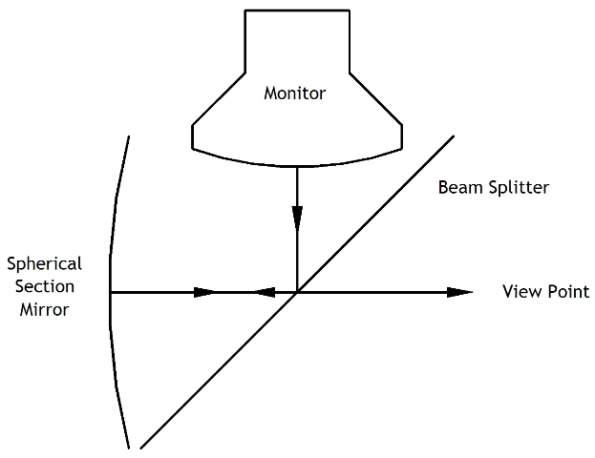
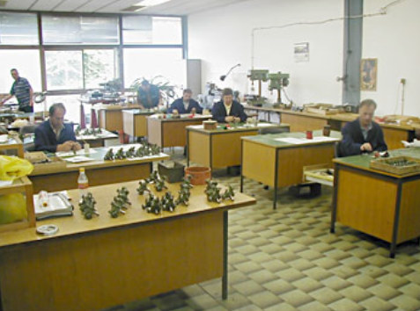


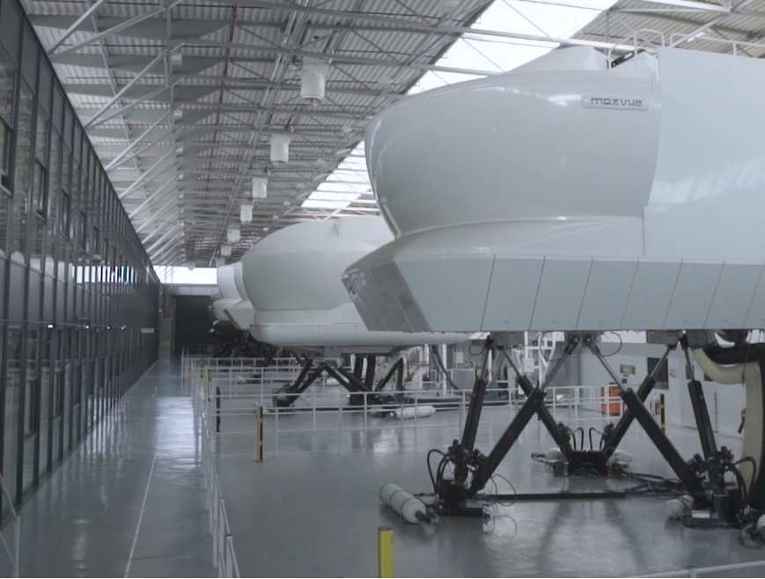
Designing flight simulator from 1982
First flight simulator optical system designed at Zrak Sarajevo
-Senior optical system designer
ZRAK DD
Premium optical and optoelectronic devices and laser devices
Company started in 1948
- Operates using internal ZRAK Standard quality system (ZS)
Designing flight simulator in 1918
CAE Inc
- Senior Optical system Designer
-Technical Lead in Visual Display System (VDS) Group
CAE Inc
“…- Each year we train more than 120,000 civil and defence crewmembers and thousands of healthcare professionals worldwide”
- Over 9,000 employees
- 160 sites and training locations in over 35 countries

Slide 4
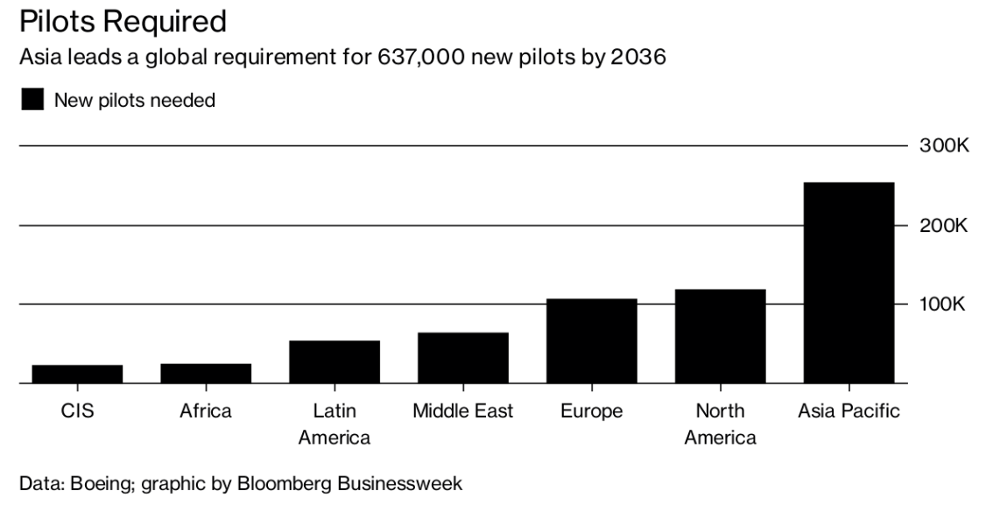
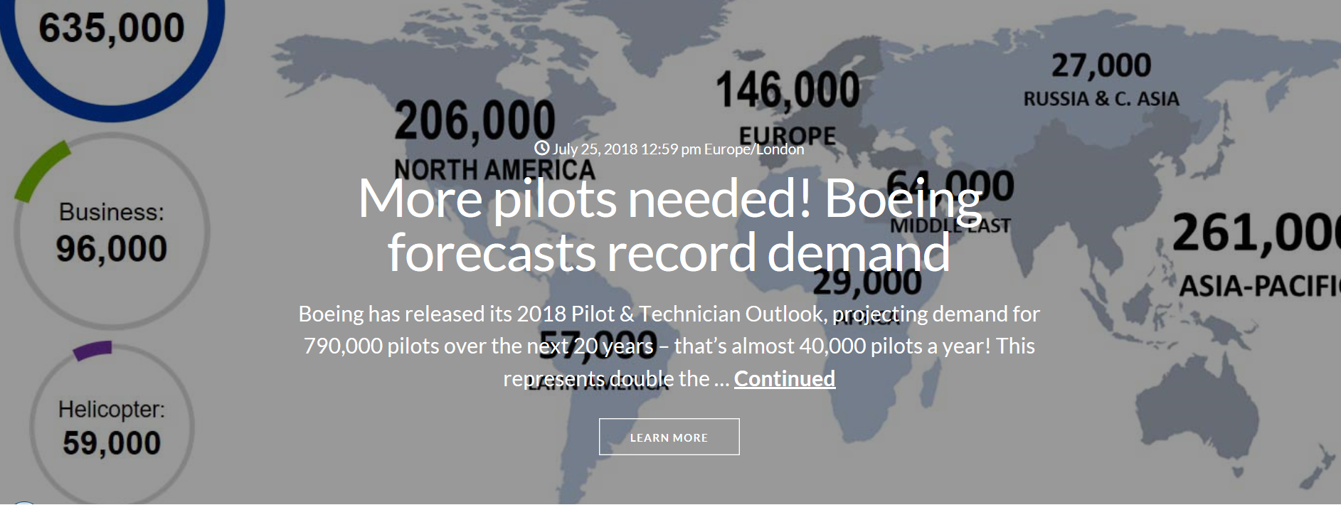
Flight Simulator industry
Satisfy flying industry needs
Very fast growing demand for new pilots
- general evaluation predicts more than 500000 pilots needed in next 20 years
- according some evaluation 40000 new pilots per year (civil)
New technology for training
Evaluation of virtual reality implementation in a flight training

Slide 5
Flight Simulator industry
“The global flight simulator market revenue is expected to reach USD 5.62 billion by 2024..”
Full flight simulator price, depending of requirements for training, is evaluated
500.000 USD$ - more than 40 Millions USD$
Average Full Flight Simulator (FFS) for civil aviation 25 millions USD$
Average FFS maintenance cost FFS ~1 Million USD$ / year
Consequences
Very big competition
Very demanding customers
Very demanding Flight Simulator regulations for different countries
- FAA (Federal Aviation Administration - USA)
- EASA (European Aviation Safety Agency)
- CASAR (Civil Aviation Safety Regulation - Australia)
- ICAO (International Civil Aviation Organisation)
- ……

Slide 6
Flight Simulator industry
Certification
-Civil aviation
-The training can be performed only on a flight simulator certified by designated Authorities
Military aviation
-Depending of contract
Winning condition for flight simulator design and production
Very good quality
Competitive price
Capacity to support very short schedule
First time right and on time
Very good customer support

Slide 7

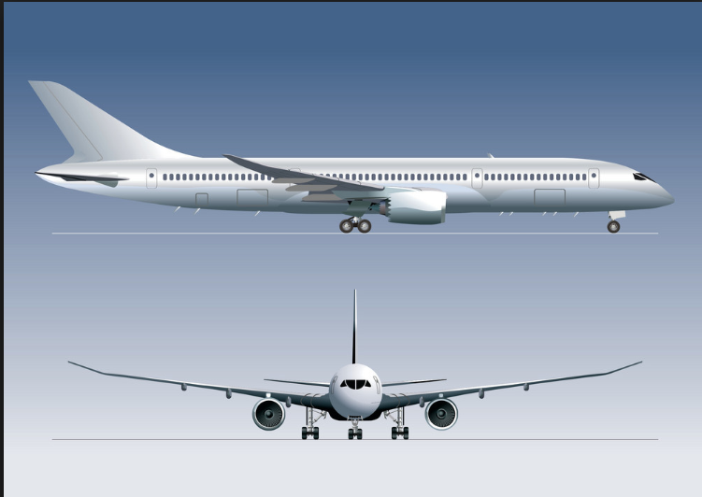
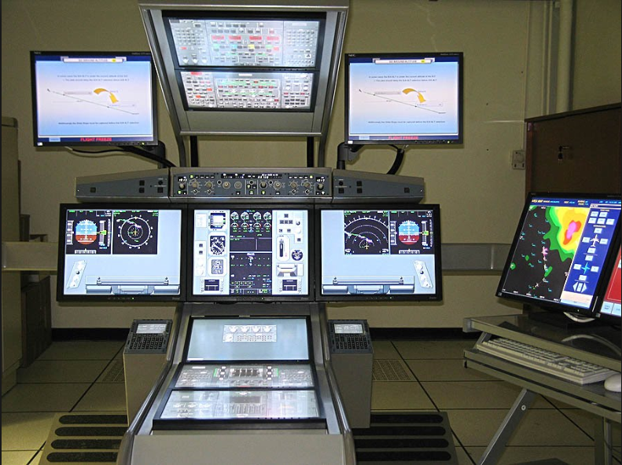
Flight simulators
Research and Development ( R & D ) simulators
- Evaluation of new plain behavior
- A 380 and B 787 simulators were used to confirm the final plain design
- Evaluation of new requirements for flight simulator
Training simulators
- Each type of plain need to have specific simulator
- Flight Training Device (FTD) - fixed training device (lower level training devices)
- Full Flight Simulator (FFS) - motion training device (high level training devices)

Slide 8
Flight simulators Requirements
Objective / measurable
- Latency
- Field of View (FOV)
- Brightness
- Resolution
- Contrast
Subjective based on perception
- “non distractive” characteristics
- perception of height, depth, distance, …
- smearing (motion blur, dynamic resolution, retinal smearing)
- motion sickness

Slide 9
physicists are involved in design and production of
Visual System
Motion System
Flight System
Proposals
Design
Design meetings with customer
Testing and testing documentation
Acceptance with customers
Certification with Authorities

Slide 10
Flight Simulator Visual systems
Display systems
Projection systems
-Blending subsystem
Calibration/ auto-calibration system
Image generators (IGs)
Data Base (DB)

Slide 11
Flight Simulator Visual Display and projection systems
Different requirements for
- Fixed wings
- Collimated systems
- FOV 200º horizontal x 40º vertical (per standard)
- Helicopters
- Collimated or direct projection systems
- FOV 180º horizontal x 60º vertical (per standard)
High brightness (illuminance) at Pilot Eye Point (PEP) or Co-pilot Eye Point (CEP)
High resolution at PEP and CEP
High contrast
Realistic perception
Customer are demanding more than prescribed minimum

Slide 12
Flight Simulator visibility / windows plot
First step
- Evaluate Design Eye Point (DEP) and PEP and CEP
- Flight Simulator Visual System Eye point needs to correspond to Cockpit Eye Point
- Evaluation of Viewing Volume
- Evaluate visibility plot from PEP and CEP (if they are not same)
-cockpit windows coverage with projected image
- number of projected channels
- projectors and lenses
- blending solution

Slide 13
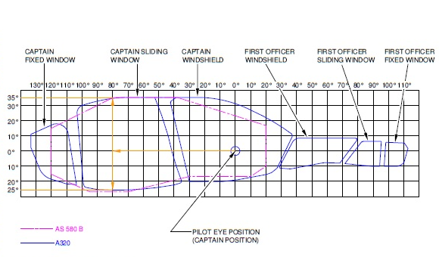
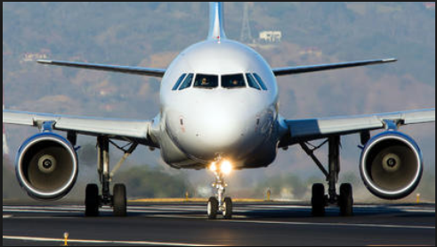
Flight Simulator visibility / windows plot
Collimated flight simulators covering FOV with 3 – 5 channels with optional additional chin windows channel
Information from internet

Slide 14
Flight Simulator visibility / windows plot
Direct projection flight simulators covering FOV with 8 – 10 channels with optional chin windows channel
Information from internet

Slide 15
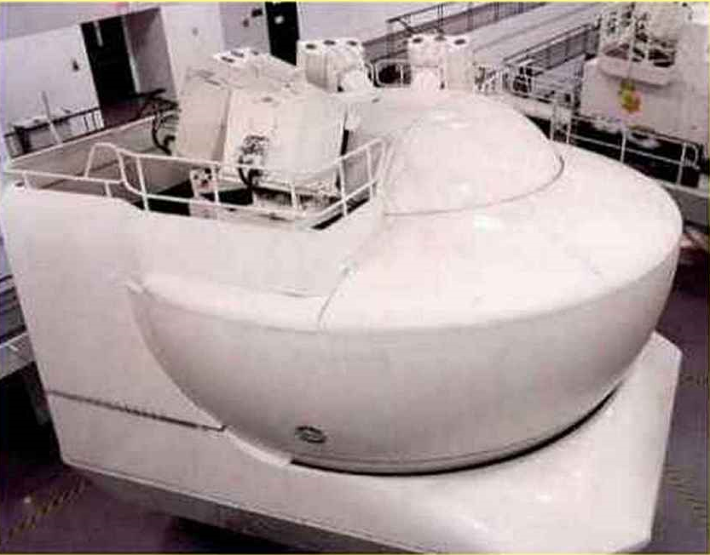
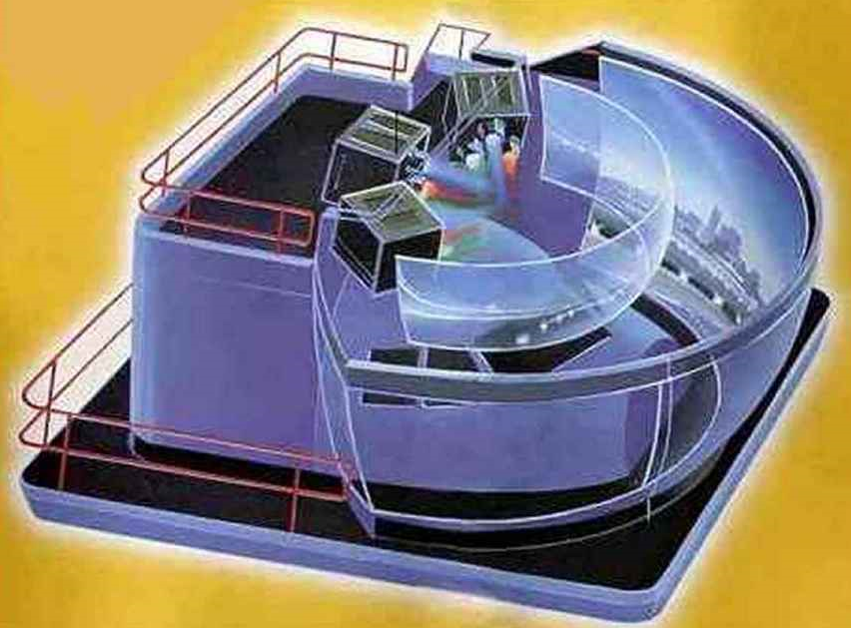
Flight Simulator Collimated Display Systems
Collimated flight simulators covering FOV with 3 – 5 ( or more) channels with optional additional chin windows channels
Projection screen
- Acrylic material
- Generally spherical or toroidal surface
- Back Projection Coating
Collimating mirror/s
- Spherical or surface
- Mylar - Chips bag material
- Glass mirror
Information from internet

Slide 16
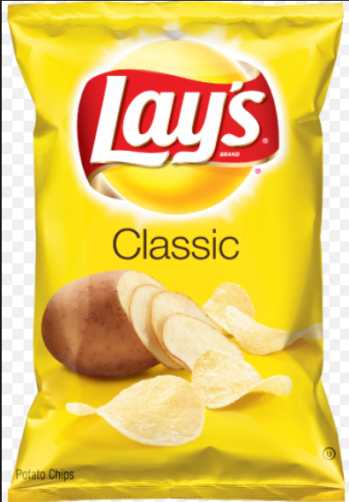
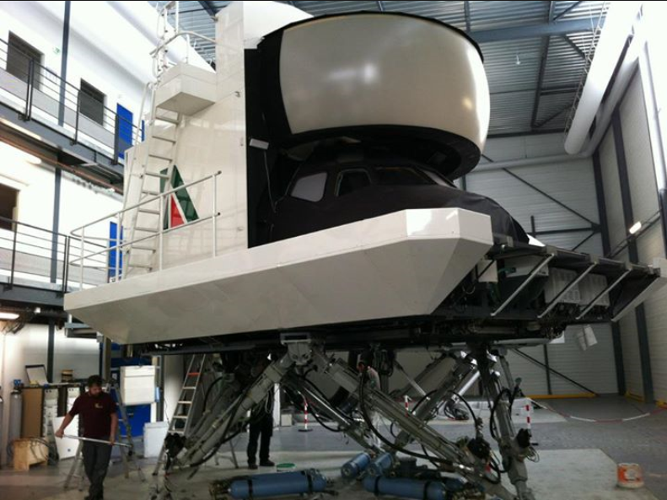
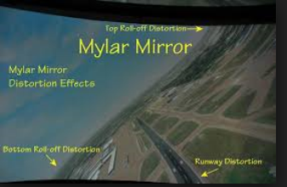
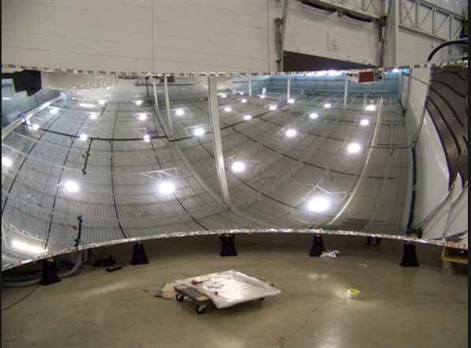
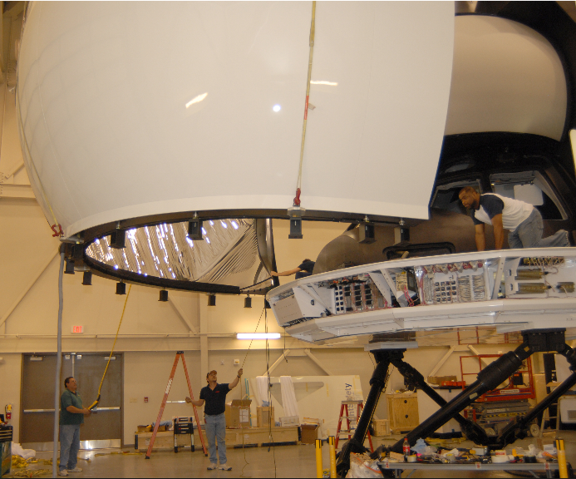
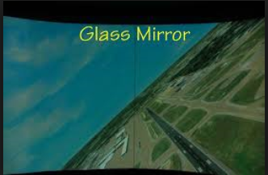
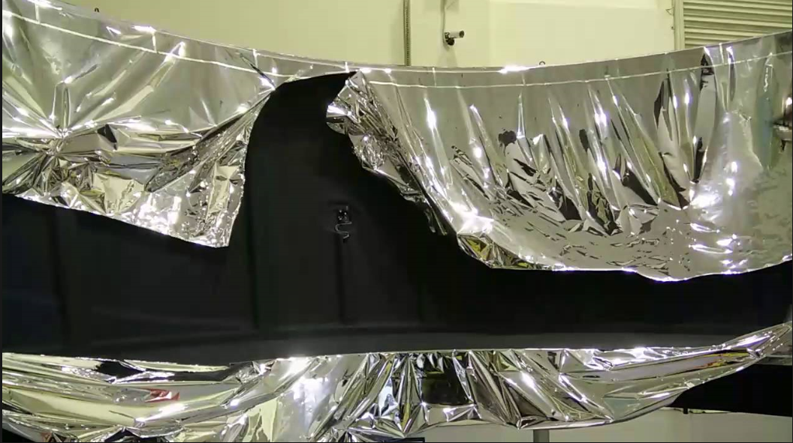
Flight Simulator Collimated Display Systems
Mylar - Chips bag material
Information from internet

Slide 17
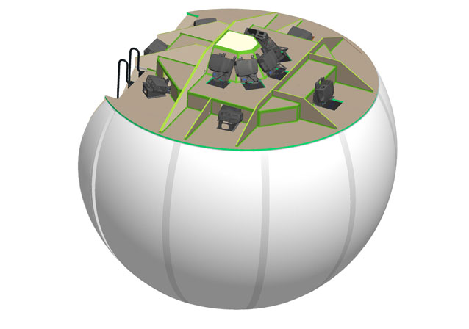
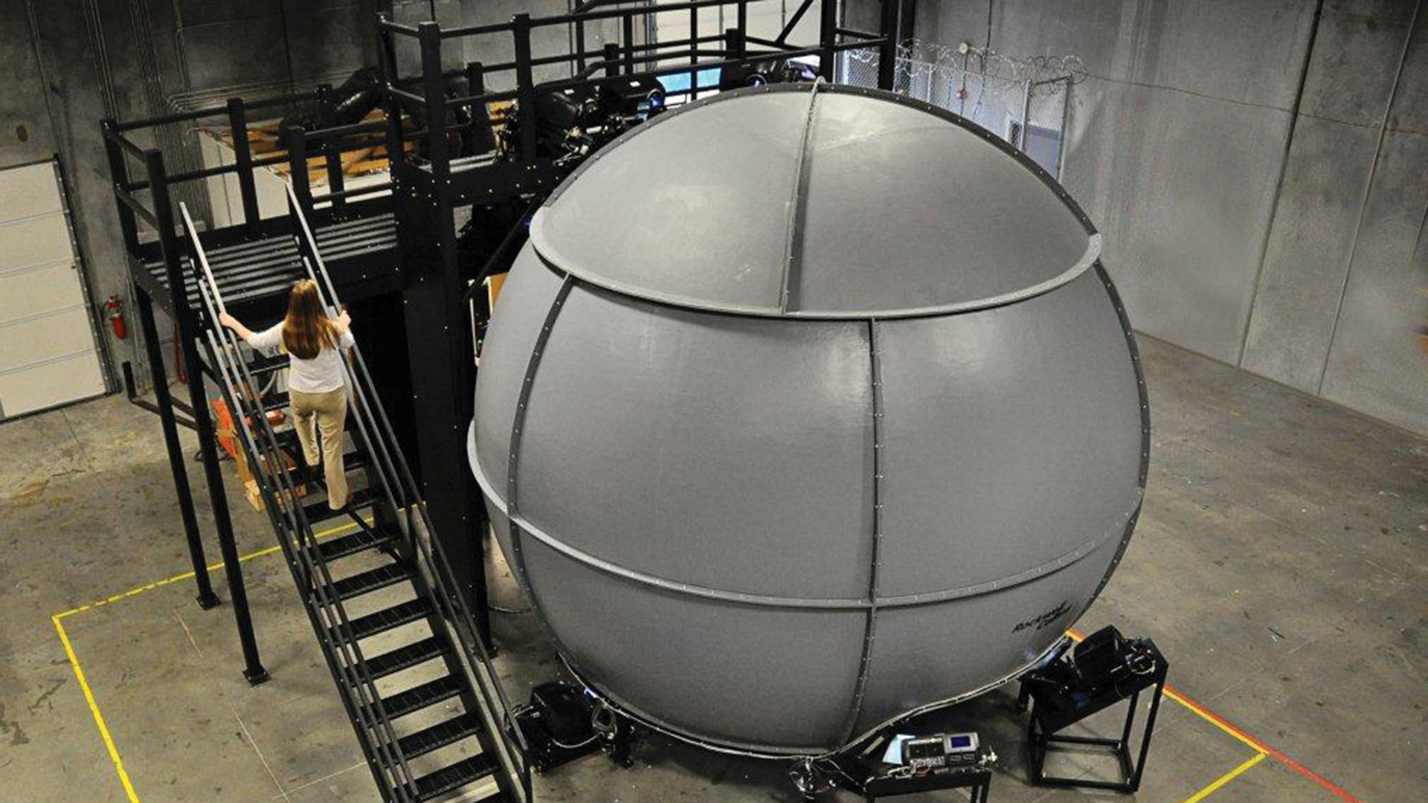
Flight Simulator Direct Projection Display Systems
Direct projection flight simulators covering FOV with 8 – 10 channels with optional chin windows channel
Projection screen
- Numbers of element depend of FOV
- Spherical surface
- Generally Front Projection Coating
Information from internet (RSI and RC)

Slide 18
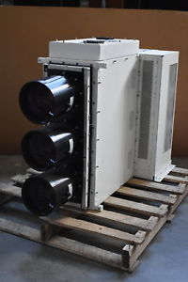
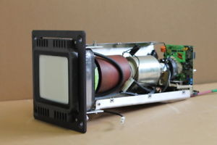
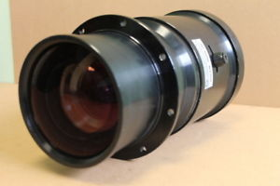
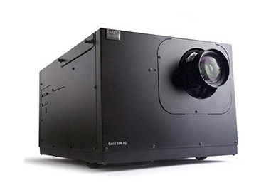
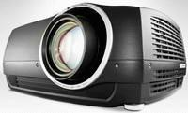
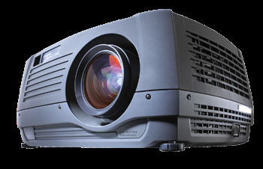
Flight Simulator Projection System
Information from internet
Projection system – Projectors using different technology
CRT (Cathode Ray Tube)
Absolete
Pro | Cons
Black is black (good black level) (optical blending not required) | Very big and heavy
Small light point size | Demanding alignment (3 lenses per projector)
Calligraphic light point | Low brightness
No Smearing | High maintenance required
LCoS (Liquid Cristal on Silicon)
DLP (Digital Light Processing)
LED (Light Emitting Diode)
Pro | Cons
High resolution | Black is not black (optical blending required)
High brightness (DLP , LCoS) Higher brightness than CRT (LED) | Cross reflection; baffles required
Better weight | Smear reduction needed (retinal smearing)
Lower maintenance

Slide 19
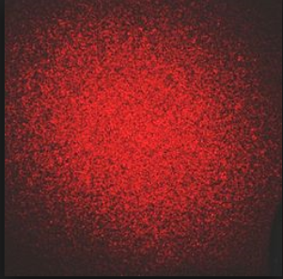
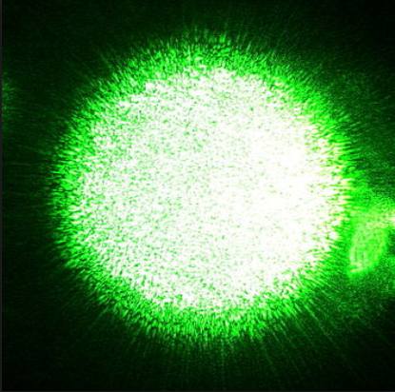
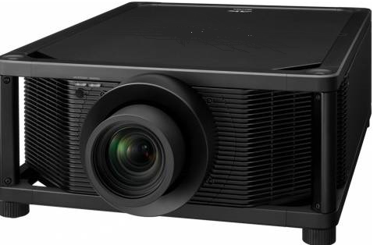
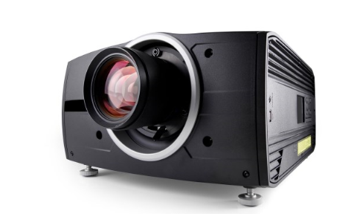
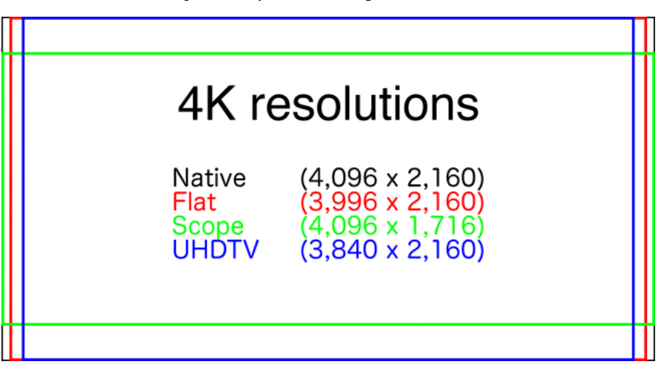
Flight Simulator Projection System
Information from internet
Projection system – Projectors using different technology
Speckle pattern
Laser Hybrid technology
- 4 K resolution (4096 x 2160)
- Different supplier using a deferent approach
- Native 4K
- WQXGA (2560 x 1600) with shift

Slide 20
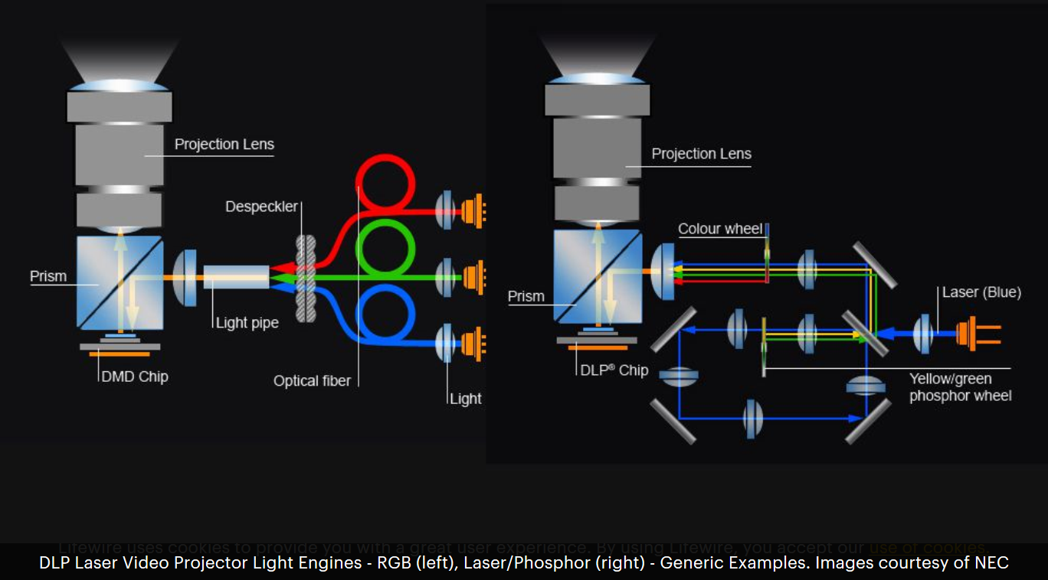
Flight Simulator Projection System
Information from internet
Laser Hybrid technology A lot of options
RGB Laser (DLP)
RGB Laser (LCD/LCOS)
Laser/Phosphor (DLP)
Laser/Phosphor (LCD/LCOS)
Laser/LED Hybrid (DLP)

Slide 21
Flight Simulator optical blending
2 channels overlap
4 channels overlap
Intensity brightness
4 channels
2 channels
3 channels
channels dimesions
No channels overlap
3 channels overlap
Information from internet

Slide 22
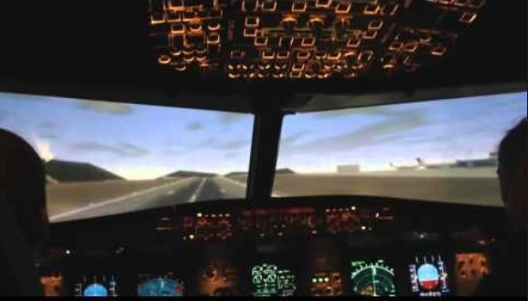
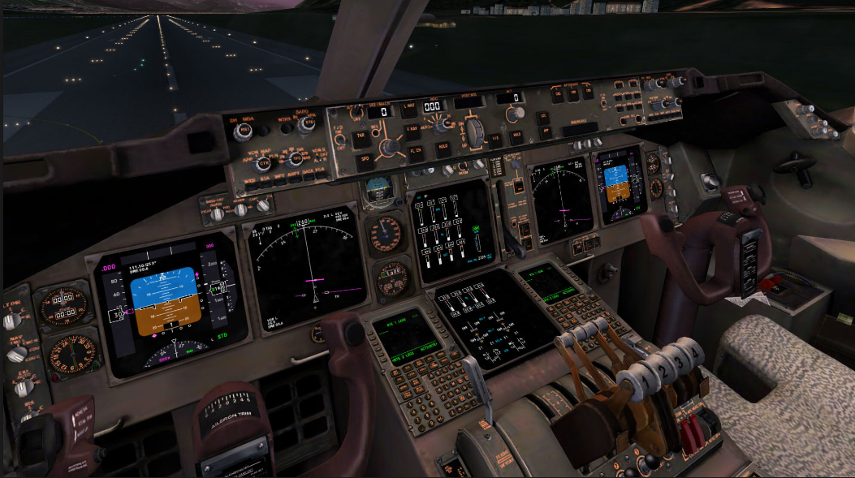
Flight Simulator optical blending
Blend zones optical and electronic blending
Intensity brightness
Information from internet

Slide 23
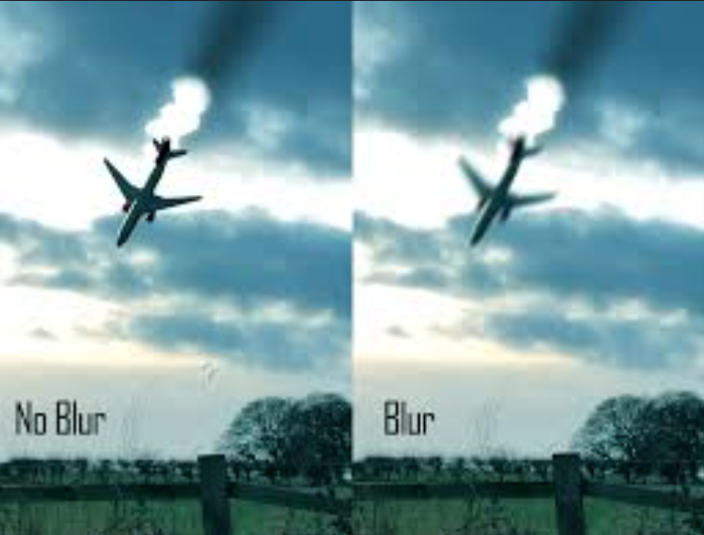

Flight Simulator optical smearing
Information from internet

Slide 24
Flight Simulator Industry
Very large domain giving a lot of possibilities for physicists
Information from internet

