Slide 1





Vremenski razlučiva Raman spektroskopija kolektivnih stanja daleko izvan ravnoteže
Damir Dominko, V. Grigorev, V. V. Kabanov, J. Demsar
Institute of Physics Zagreb
University of Mainz

Slide 2
Kolektivno stanje i parametar uređenja
Princip praćenja ultrabrzih procesa
Primjer: (NbSe₄)₃I
Rezultati jakih pubuđenja

Slide 3
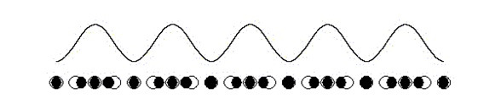
Kolektivna stanja
Obično modulirane strukture/superstrukture
Niska dimenzionalnost
~0.8e
~0.3e
α‑(BEDT-TTF)₂I₃
T. Ivek et al, PRL 104, 206406 (2010)
4
4
4
3
D=1
3
D=2
3
D=3
χ
2
χ
2
χ
2
1
1
1
0
0
2k_{F}
k
0
0
2k_{F}
k
0
0
2k_{F}
k
Lindhard response function at 0K
Notes:
carge transfer salts
BEDT.. molecules

Slide 4
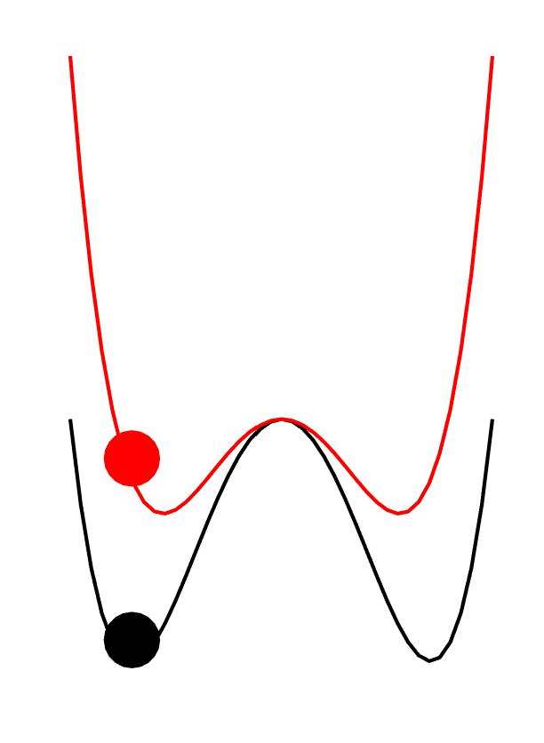

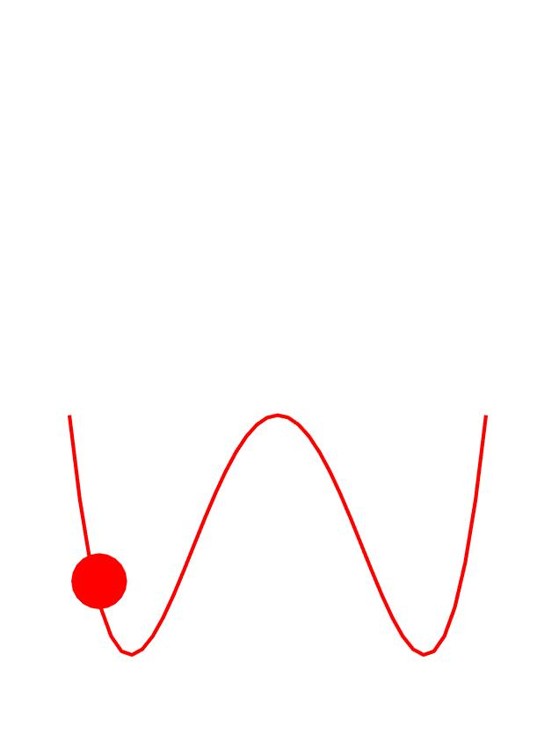
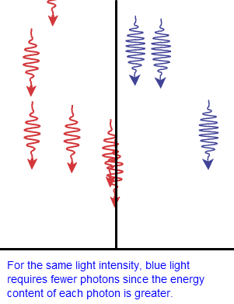
Parametar uređenja u potencijalu
Faza:
0
π/2
F
F
Δ
Δ
0
0

Slide 5
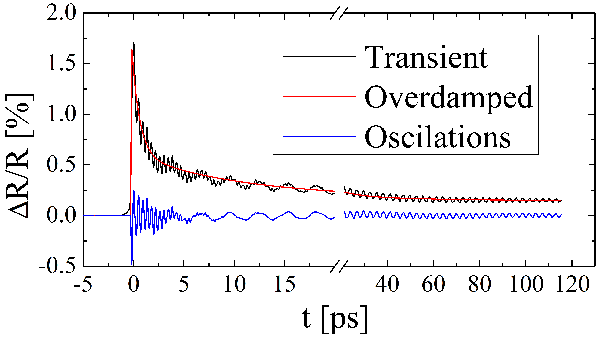
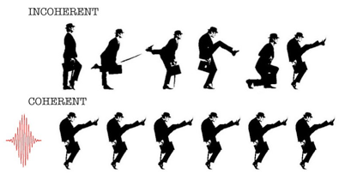
Praćenje ultrabrzih procesa
(NbSe₄)₃I
Komponente:
Fononske: A, f, Γ, φ
Elektronske: A, Γ/τ
K_{0.3}MoO₃
Time resolved
http://www.nims.go.jp/ldynamics/en/
Raman

Slide 6
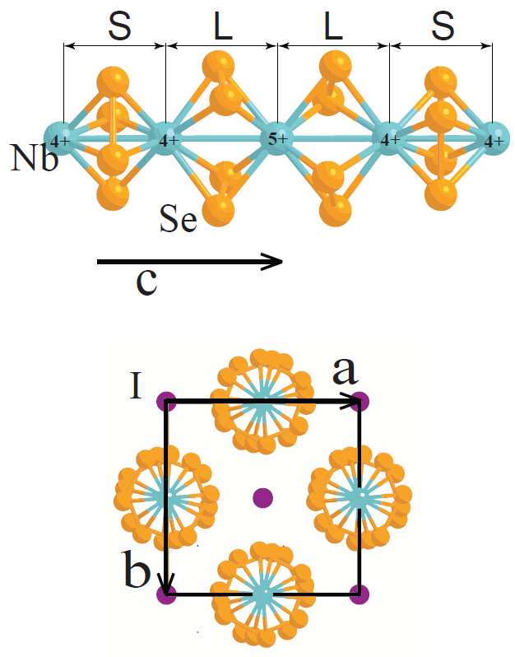
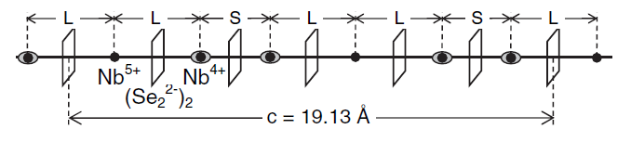
(NbSe₄)₃I
AFE
Pseudo- Jahn Teller
XRD at 128 K: length L splits in two: L and I
XRD at 30 K: length I becomes even shorter
- LLS-LIS-LSS transitions
P4/mnc - P42₁c - P4 space group transition
Notes:
P4/mnc - P42₁c - P4
(D6_4h)-(D4_2d)-S1_4

Slide 7
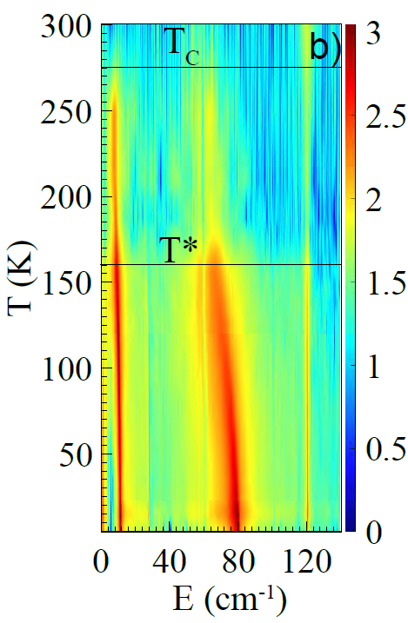
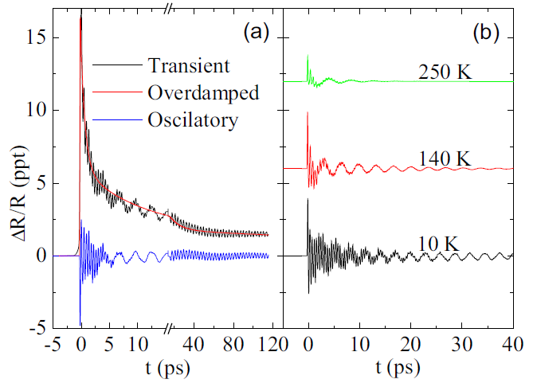
(NbSe₄)₃I

Slide 8
(NbSe₄)₃I – efekt jake perturbacije
Vremenski ovisna frekvencija moda
- Red shift by ΔE
- Phonon energy recovery in τ_{E}

Slide 9
(NbSe₄)₃I – 3 pulse experiments
D
P
SAMPLE
p
t
t₁₂
P-p par - Raman proba
→ D-P-p set – vremenski razlučiva Raman spektroskopija

Slide 10
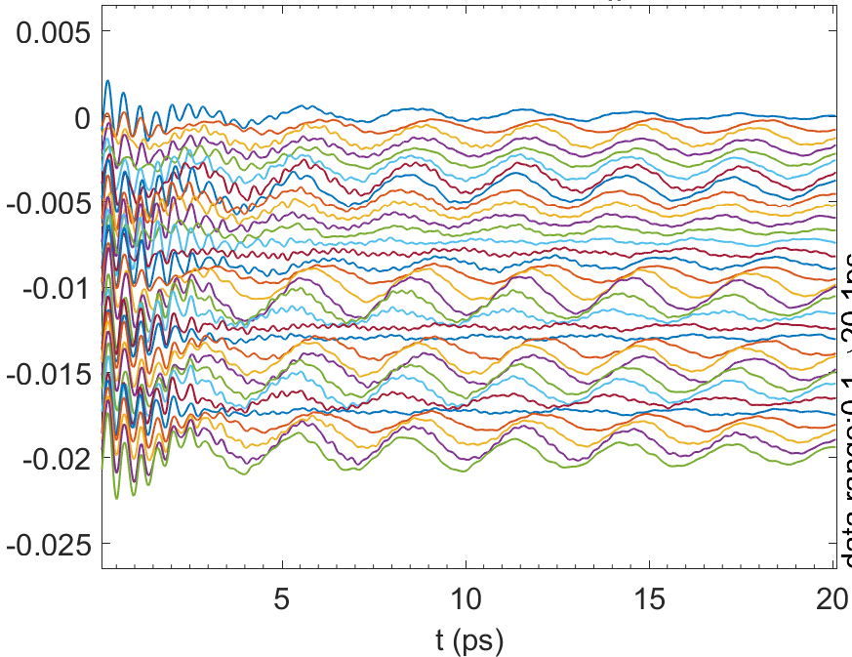
(NbSe₄)₃I – 3 pulse experiments
2 mJ/cm²
t₁₂~∞
t₁₂=0.2 ps
Oscillatory traces vs. t₁₂
2.6 ps
5.5 ps
2.8 ps → 12 cm⁻¹

Slide 11
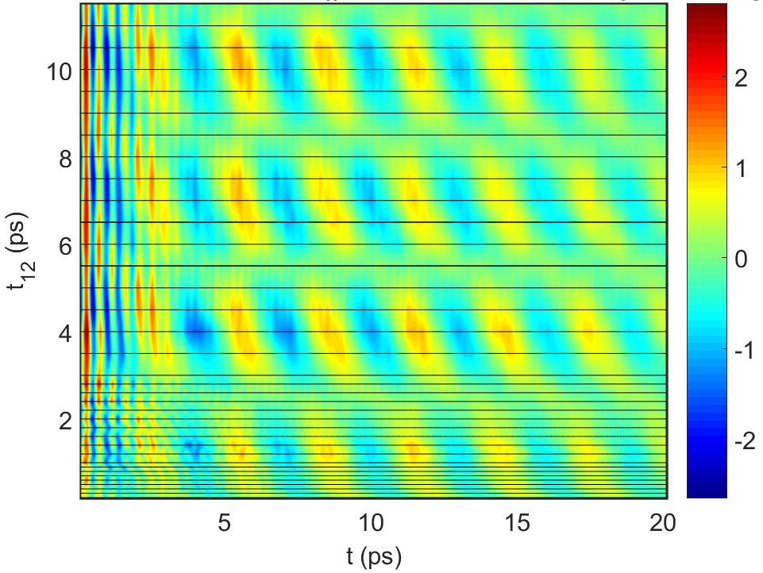
(NbSe₄)₃I – 3 pulse experiments
2 mJ/cm²
2.8 ps → 12 cm⁻¹

Slide 12
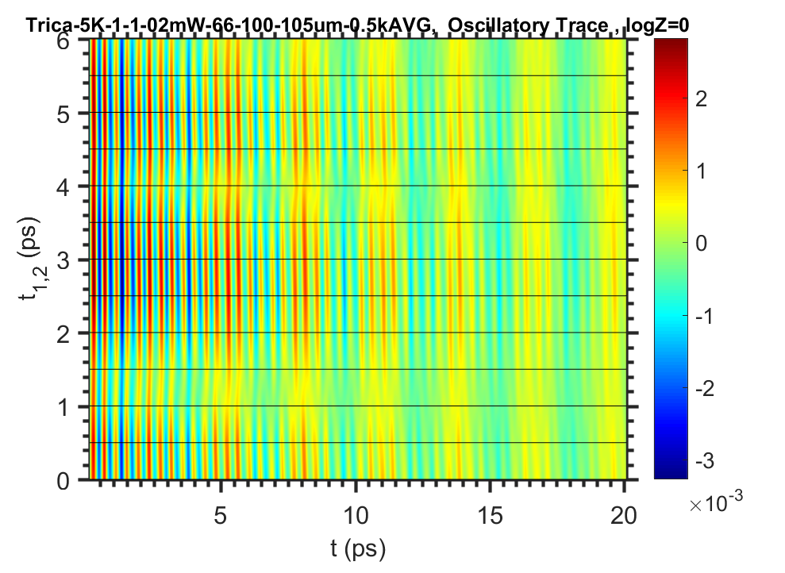
(NbSe₄)₃I – 3 pulse experiments
0.1 mJ/cm²

Slide 13
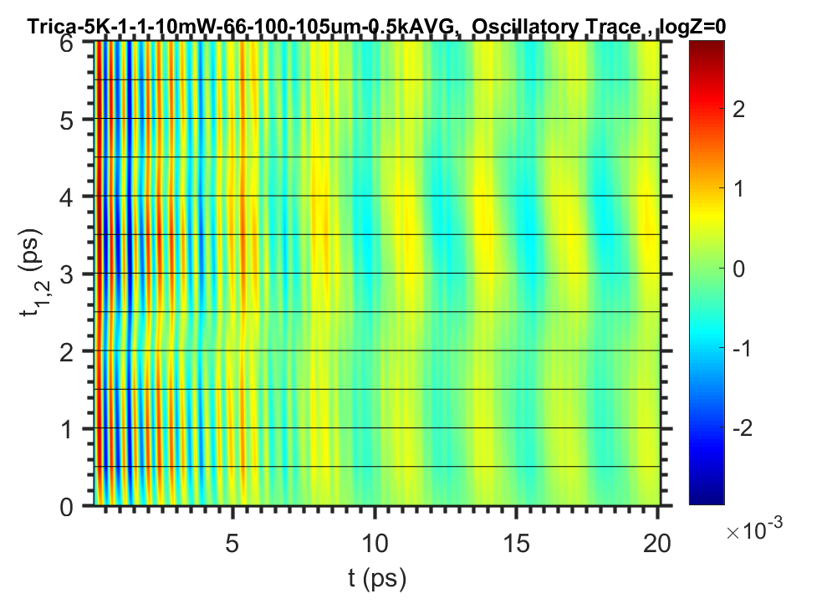
(NbSe₄)₃I – 3 pulse experiments
0.5 mJ/cm²

Slide 14
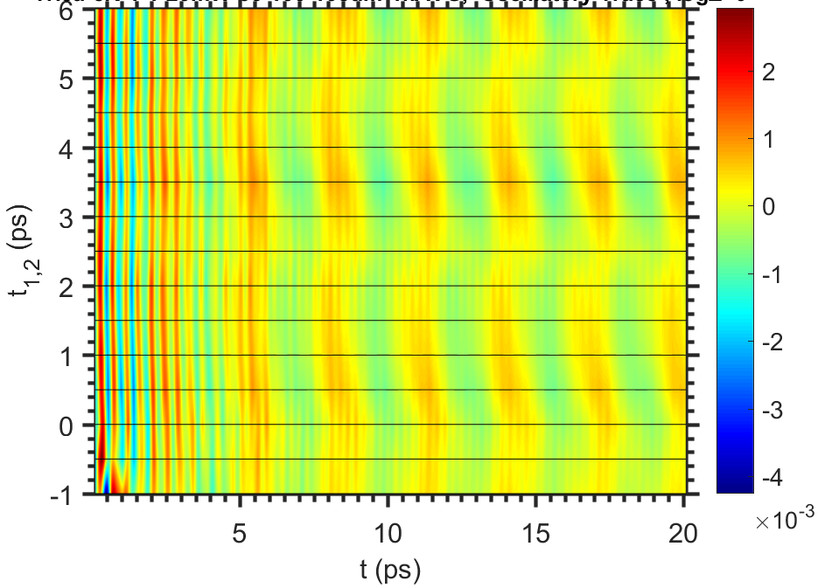
(NbSe₄)₃I – 3 pulse experiments
1 mJ/cm²

Slide 15
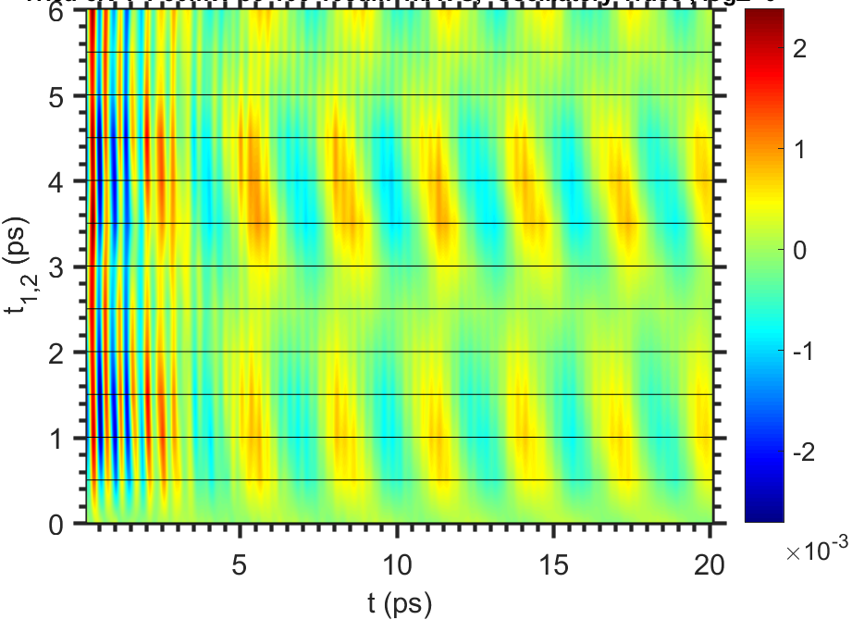
(NbSe₄)₃I – 3 pulse experiments
1.5 mJ/cm²

Slide 16
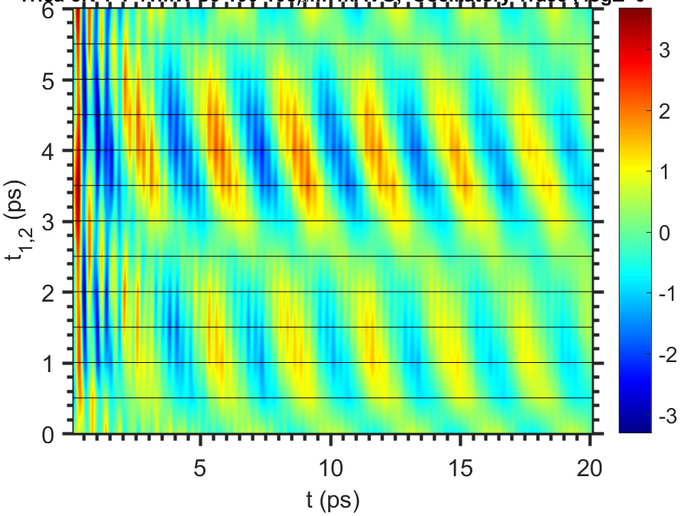
(NbSe₄)₃I – 3 pulse experiments
2 mJ/cm²

Slide 17
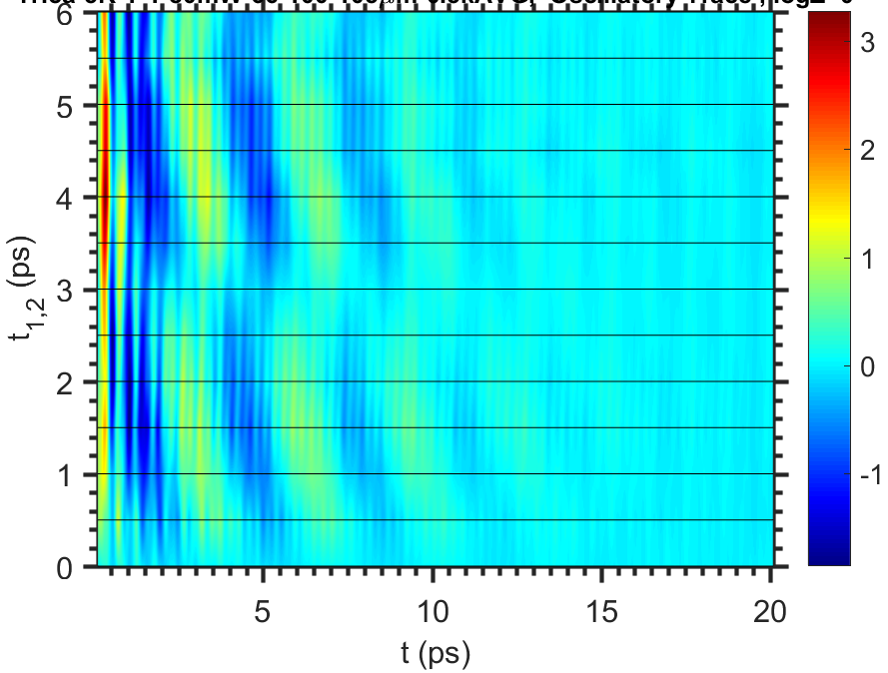
(NbSe₄)₃I – 3 pulse experiments
4 mJ/cm²

Slide 18
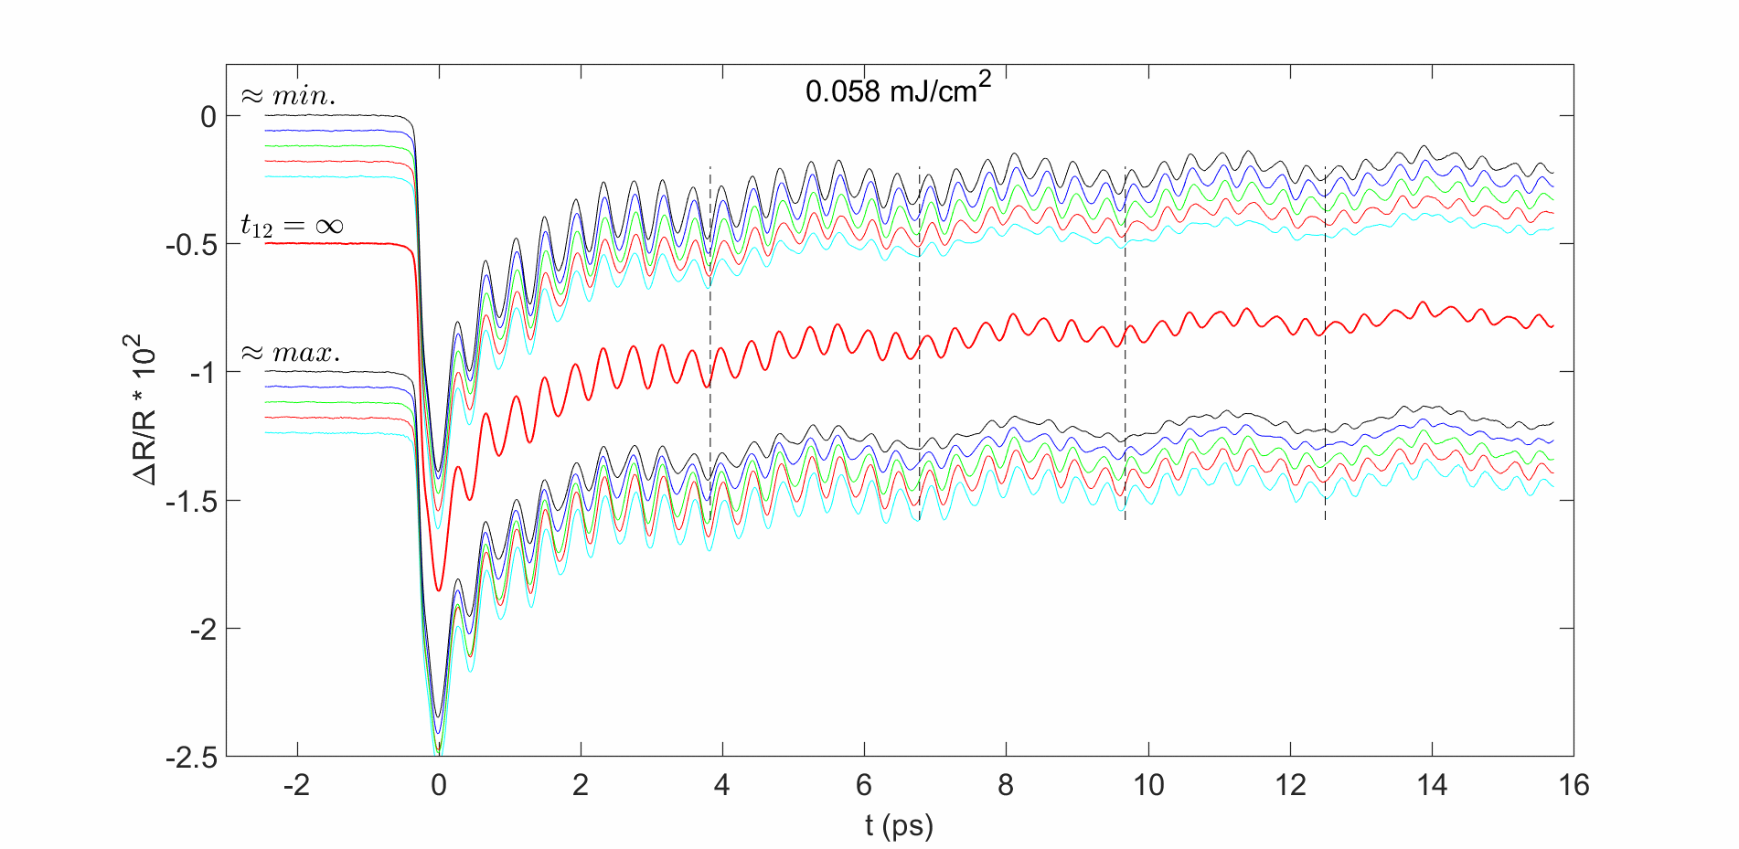
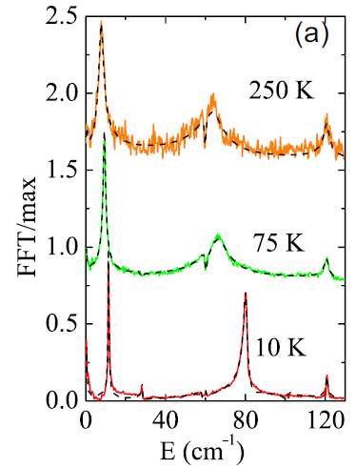
(NbSe₄)₃I – 3 pulse experiments

Slide 19
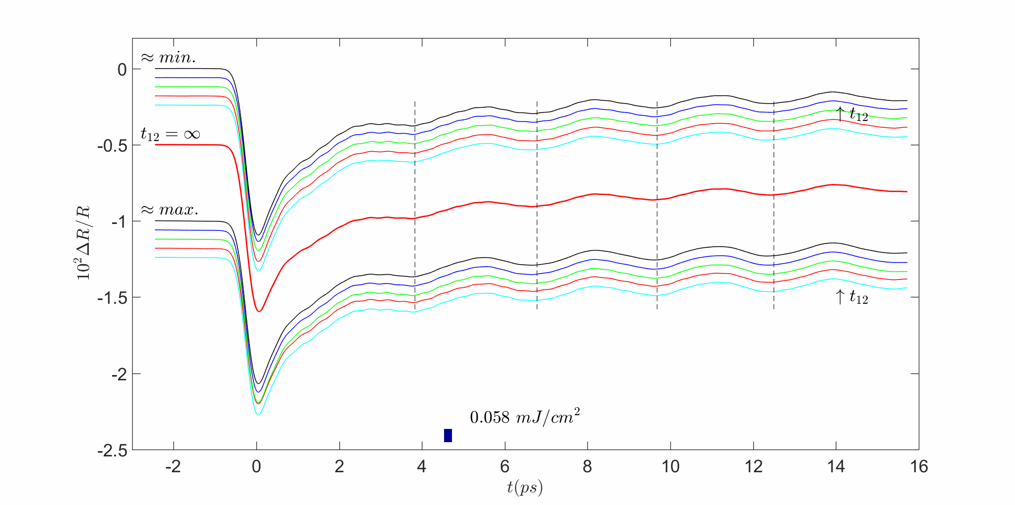
(NbSe₄)₃I – 3 pulse experiments

Slide 20
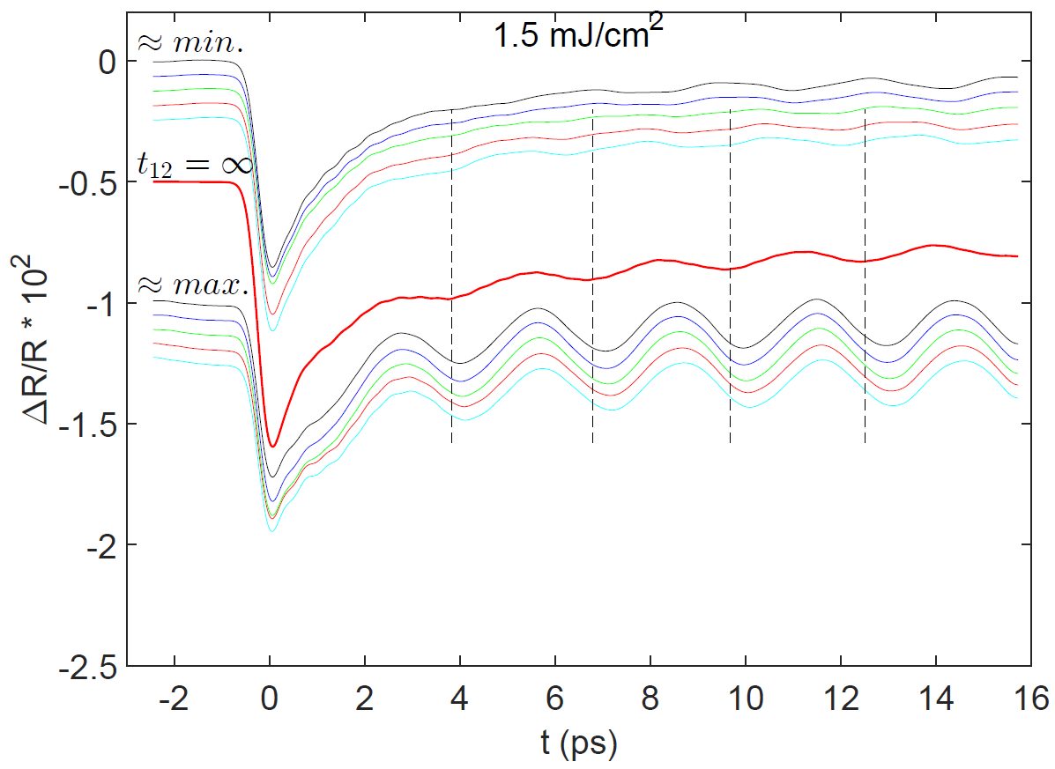
(NbSe₄)₃I – 3 pulse experiments

Slide 21
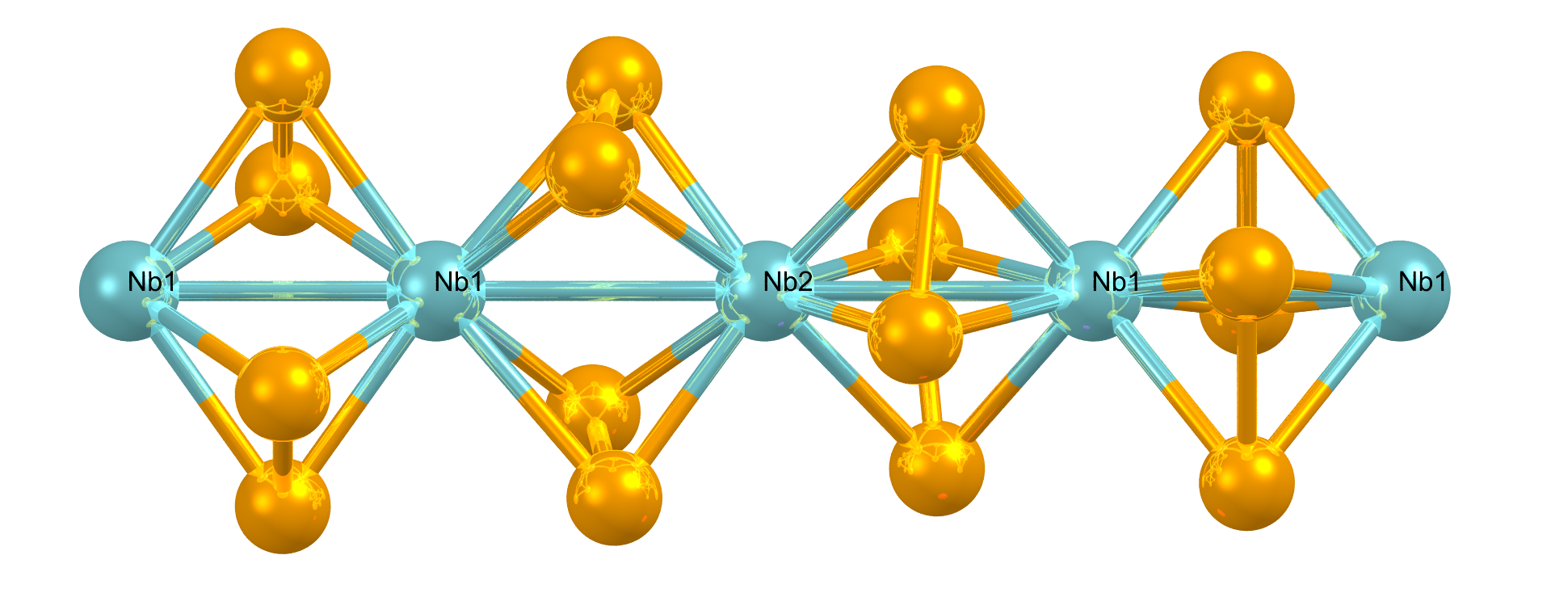
Zaključak
Kalorimetrijski: 7 mJ/cm² – grijanje za 500 K
Ravnoteža: Jahn Teller distorzija uništena
Izvan ravnoteže: distorzija očuvana i vremenski modulirana
Nagli skokovi faze za π na početku/kraju svakog perioda
Modulacija utjecaja pobude na potencijal među ionima

Slide 22
Hvala na pažnji!

Slide 23
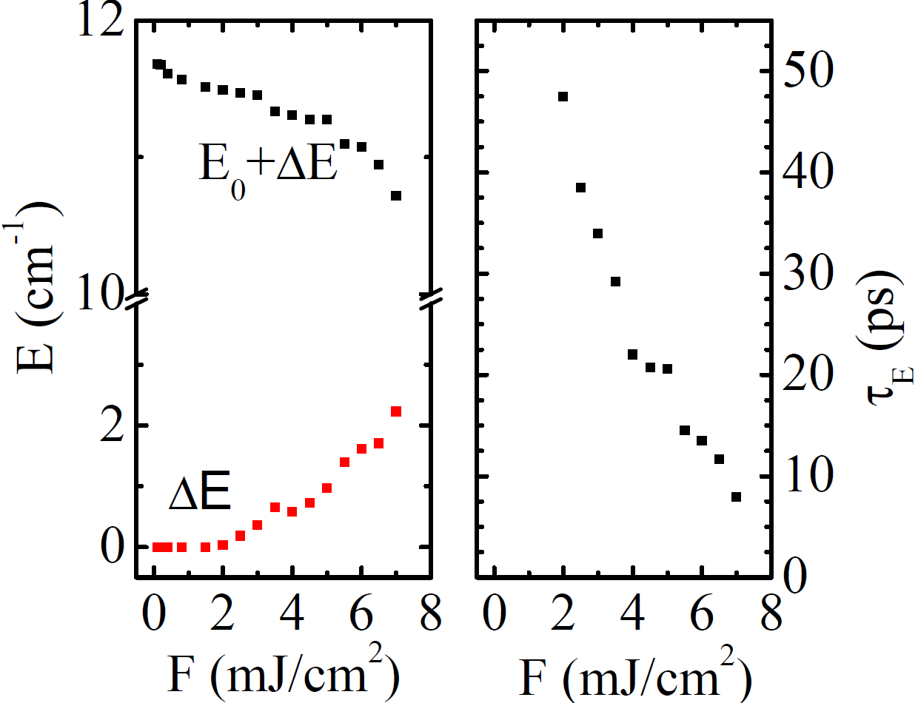
(NbSe₄)₃I – dynamics at high perturbations
Time evolution of spectra at high fluencies
- Elektron-fonon vezanje promijenjeno u kratkom vremenu

Slide 24
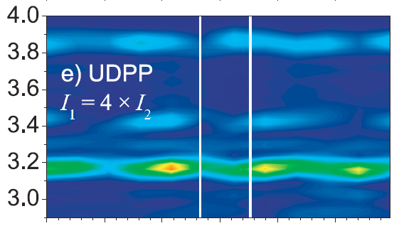

(NbSe₄)₃I – 3 pulse experiments
1T-TaS₂
P. Kusar et al. PRB 83, 035104 (2011)

Slide 25
(NbSe₄)₃I – 3 pulse experiments
1T-TaS₂
+ damping, long pulses, long penetration depth
Analytic in t₁₂!!
P. Kusar et al. PRB 83, 035104 (2011)

Slide 26
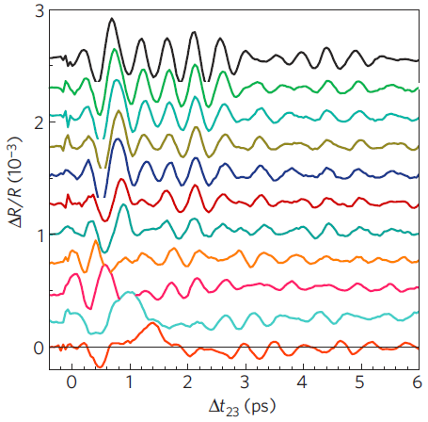
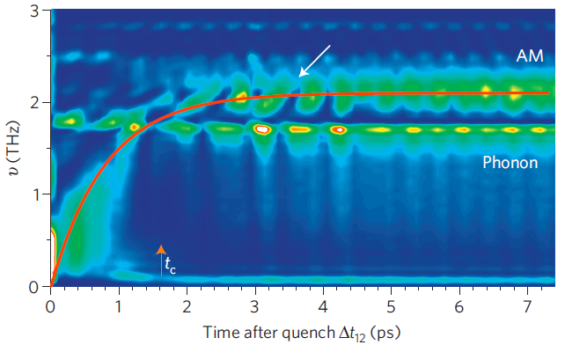
(NbSe₄)₃I – 3 pulse experiments
TbTe₃
R. Yusupov et al. Nat. Phys. 6, 681 (2010)

Slide 27
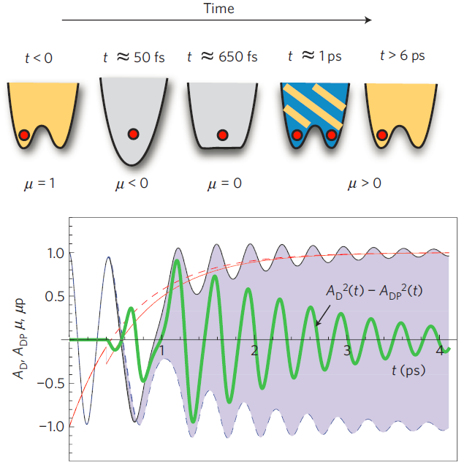
(NbSe₄)₃I – 3 pulse experiments
TbTe₃
t₁₂
Analytic in t₁₂!!
R. Yusupov et al. Nat. Phys. 6, 681 (2010)

Slide 28
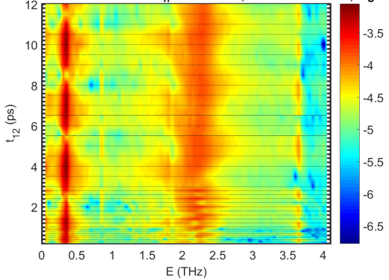
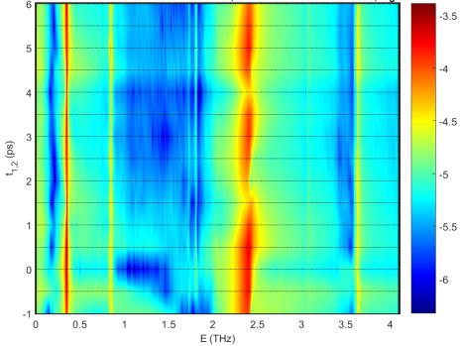
(NbSe₄)₃I – 3 pulse experiments
2 mJ/cm² 0.25 mJ/cm²

Slide 29
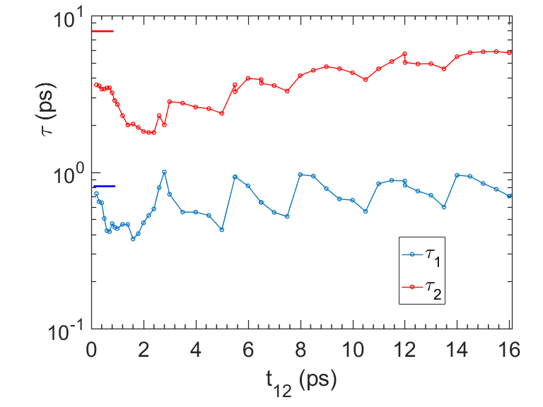
(NbSe₄)₃I – 3 pulse experiments
2 mJ/cm²

Slide 30
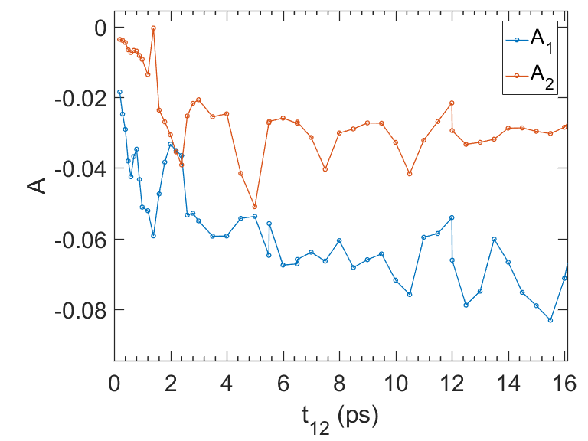
(NbSe₄)₃I – 3 pulse experiments
2 mJ/cm²

Slide 31
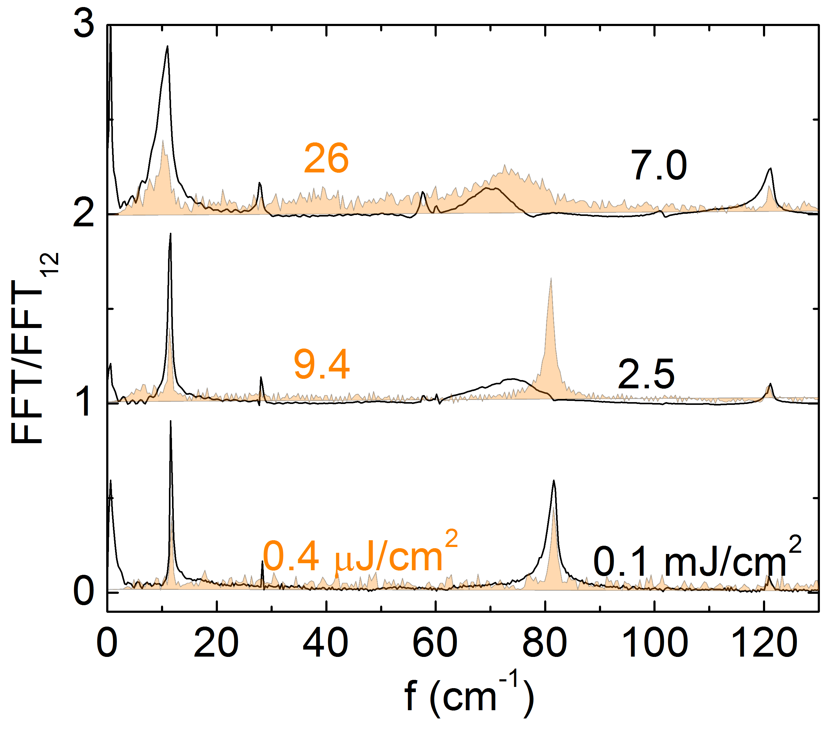
(NbSe₄)₃I – high fluencies
Same CW power, different repetition
- resolving steady state heating

Slide 32
Probing of ultrafast dynamics
Laser

